Slide 1
Events Management: Principles & Practice, 4th Edition
By Razaq Raj and Tahir Rashid

Slide 2
Chapter 5 Financial Management in the Events Industry
The principles of financial management
Regulatory frameworks of accounting
Understanding the financial statements
Trading, profit and loss account
The balance sheet
Accounting Ratios Analysis
Budget Process

Slide 3
The Principles of Financial Management
Financial accounts are concerned with classifying, measuring and recording the transactions of a business
At the end of a period (typically a year)
The systematic recording, reporting, and analysis of financial transactions of a business

Slide 4
Traditional Accounting Disciplines
Financial Accounting
Management Accounting
Financial Management
Auditing

Slide 5
Fundamental Statements for Auditor’s Report

Slide 6
The regulatory framework
Preparation of financial accounts are governed by the Companies Act 2006
The UK is member of the European Union and companies need to comply with legal requirements which are set by the EU
Company law provides the legal framework
Accounting standards

Slide 7
Accounting Bodies

Slide 8
Understanding Financial Statement

Slide 9
Trial Balance
The trial balance is an act of schedule.
Lists all the ledger accounts in the form of debit and credit balances.
To confirm that total debits equal total credits.
The balance sheet and trading and profit and loss account are prepared from a list of the various balances.
The trial balance is derived from the ledger accounts at the end of the financial year.

Slide 10
The Balance Sheet

Slide 11
Profit and Loss Account

Slide 12
Accounting Ratios Analysis

Slide 13
Budgeting Process
Budgeting process are vital tool for Events managers.
Budgeting process as a tool to control the revenue and expenditure.
It is important for event manager to develop skills and strategies.
Helps event managers to establish whether the event will make profit or loss

Slide 14
Event Budget Income
Income
Event Ticket Sales | 41300
Sponsorship | 7680
Funding from Local Government | 1200
Bar/Canteen | 8500
Total Event Income | 58680

Slide 15
Event Budget Expenditure
Expenditure
Advertising | 3900
Catering | 4500
Equipment | 4590
office costs | 2500
Printing | 2005
Event Cleaners | 1340
Venue costs | 5000
Staffing Cost | 18500
Event Security | 6500
VIP Hospitality | 1790
Total Event Expenditure | 50625
Surplus / Profit | 8055

Slide 16
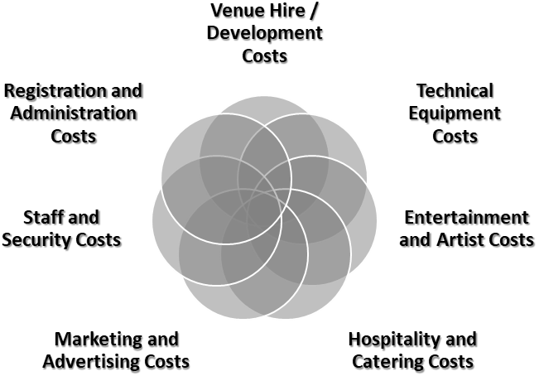
Event Costs

Slide 17
Summary
Companies need to produce annual accounts
The ratio analysis provides comparison for the events managers and organisers.
It is essential to carry out evaluation of performance of the business or event.
The corporate event industry has suffered due to lack of sponsorship and corporate deal.

Slide 18
Further Readings
Badenhausen, K. (2018) FIFA World Cup 2018: The Money Behind The Biggest Event In Sports https://www.forbes.com/sites/kurtbadenhausen/2018/06/14/world-cup-2018-the-money-behind-the-biggest-event-in-sports/?sh=5f7b21dd6973 [accessed 19/03/2021].
Elliott, B. and Elliott, J. (2019) Financial Accounting and Reporting, 19th edn. Harlow: Pearson.
Organisation Committee for the Olympic Games (OCOG) for the Olympic Games and Paralympic Games Tokyo 2020 https://tokyo2020.org/en/organising-committee/budgets/[accessed 19/03/2021].
www.culture.gov.uk/images/publications/DCMS_GOE_annual_report

